Slide 1


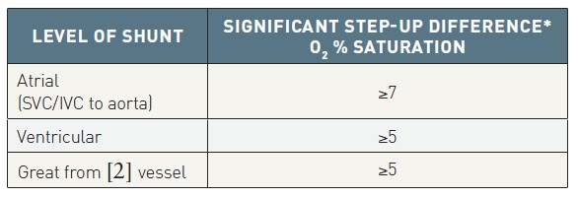

Right and left heart catheterisation (old)
Table 3
Oxygen saturation values for shunt detectionIVC: inferior vena cava; PA: pulmonary artery pressure; SVC: superior vena cava * Difference between distal and proximal chamber. For example, for atrial septal defect: MVO2 = (3 SVC + 1 IVC)/4 and difference from PA should be ≤ 7% normally. From reference [2].
Morton J. Kern
©2025 Europa Group - All rights reserved.

