Slide 1


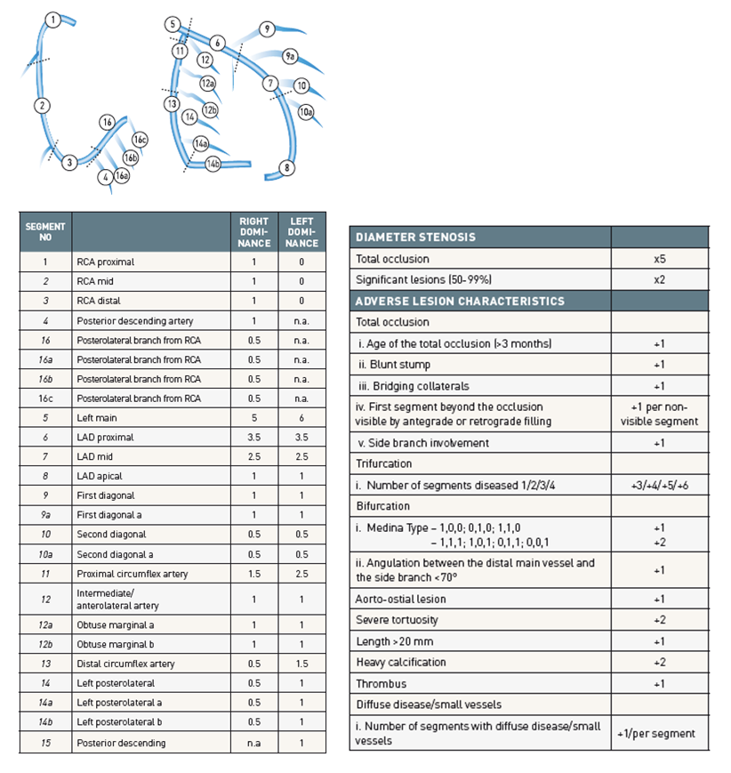

Risk stratification and risk models in revascularisation
Figure 1
The scoring of adverse lesion characteristics in the SYNTAX score. The lesion’s segment score (Left) is first multiplied by a factor of 2 or 5 depending on the diameter reduction, followed by the addition of points for adverse lesion characteristics (Right).
Hironori Hara, Kuniaki Takahashi, Vasim Farooq, David R. Holmes, Yoshinobu Onuma, Patrick W. Serruys
©2025 Europa Group - All rights reserved.

