Slide 1


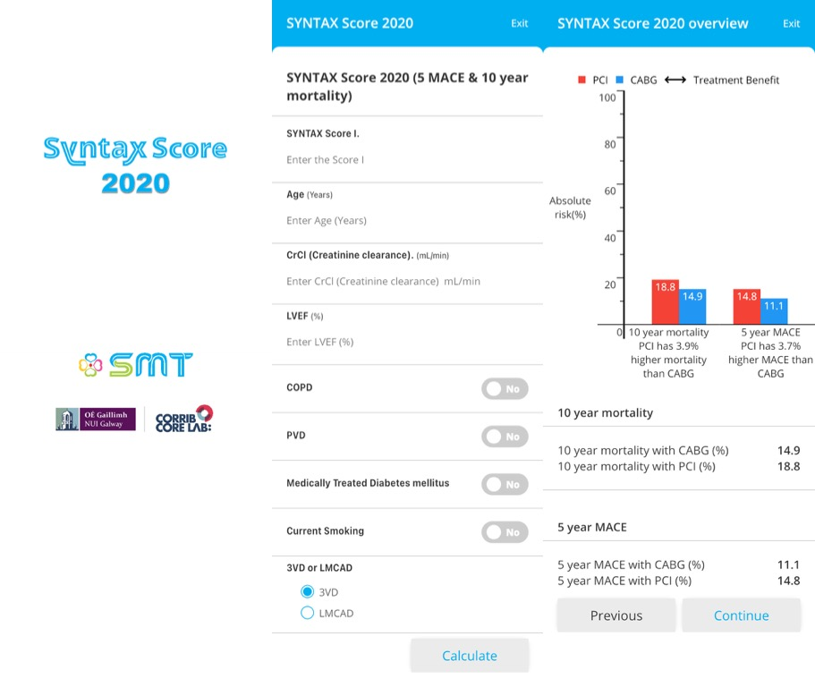
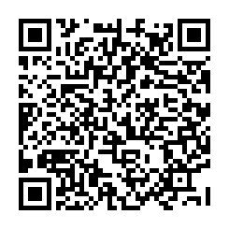
Risk stratification and risk models in revascularisation
Figure 4
Calculator for the SYNTAX score II 2020.
Hironori Hara, Kuniaki Takahashi, Vasim Farooq, David R. Holmes, Yoshinobu Onuma, Patrick W. Serruys
©2025 Europa Group - All rights reserved.

