Slide 1


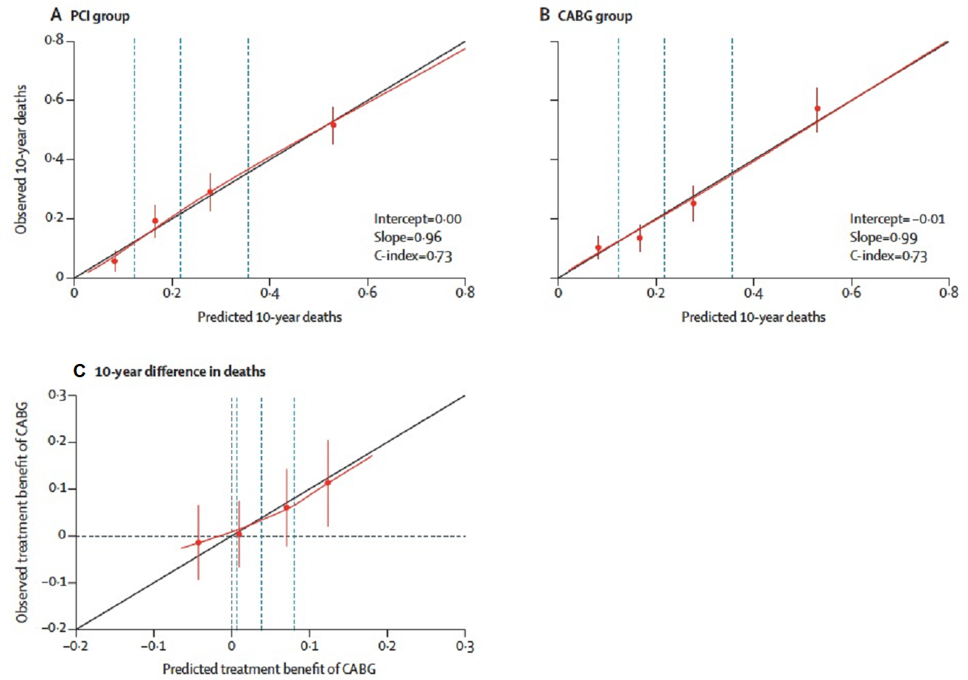

Risk stratification and risk models in revascularisation
Figure 5
Cross-validation of the SYNTAX score II 2020 for predicting 10-year death in patients with 3VD or LMCAD in the SYNTAX trial (n=1800). Calibration plots showing the observed versus predicted 10-year death according to the SYNTAX score II 2020 in the PCI group (A) and in the CABG group (B). (C) A calibration plot showing the observed versus predicted treatment benefit of CABG over PCI, in terms of 10-year death. A positive absolute risk difference represents an increase in treatment benefit of CABG over PCI. Vertical dashed lines in the calibration plots represent the quartiles of 10-year death.
Hironori Hara, Kuniaki Takahashi, Vasim Farooq, David R. Holmes, Yoshinobu Onuma, Patrick W. Serruys
©2025 Europa Group - All rights reserved.

