Slide 1


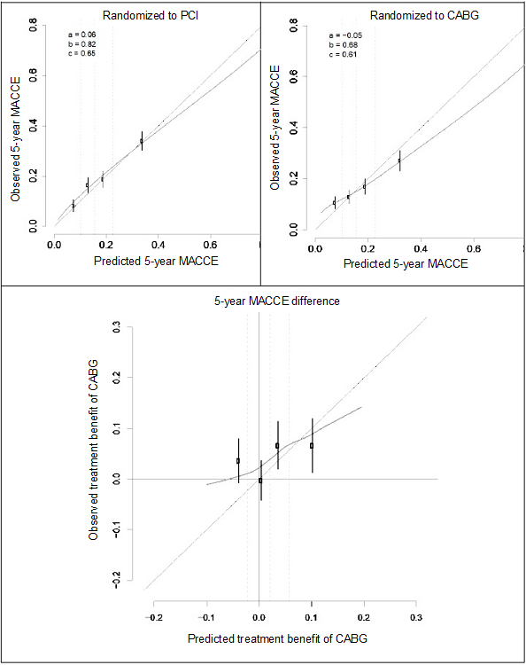

Risk stratification and risk models in revascularisation
Figure 6
Calibration plots based on an external validation of the SYNTAX score II 2020 for 5-year MACCE in patients with MVD or LMCAD of the FREEDOM, BEST, PRECOMBAT, and EXCEL trials (n=5280).
Observed versus predicted outcome risk according to the SYNTAX score II 2020 in PCI arm (upper left panel) and in the CABG arm (upper right panel), respectively. Observed versus predicted treatment benefit of CABG versus PCI according to the SYNTAX score II 2020 (lower panel). a=intercept. b=slope. c=C-index.
Hironori Hara, Kuniaki Takahashi, Vasim Farooq, David R. Holmes, Yoshinobu Onuma, Patrick W. Serruys
©2025 Europa Group - All rights reserved.

