Slide 1


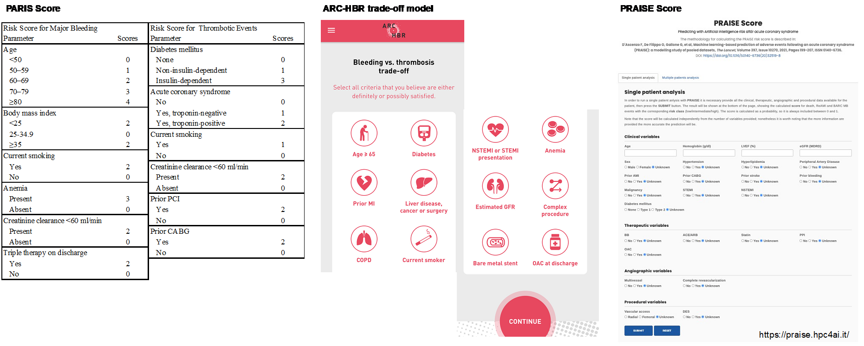

Risk stratification and risk models in revascularisation
Figure 7
Models for both bleeding and ischemic risk. (Left) PARIS score, (Middle) ARC-high bleeding risk trade-off model, and (Right) PRAISE score.
Hironori Hara, Kuniaki Takahashi, Vasim Farooq, David R. Holmes, Yoshinobu Onuma, Patrick W. Serruys
©2025 Europa Group - All rights reserved.

