Slide 1


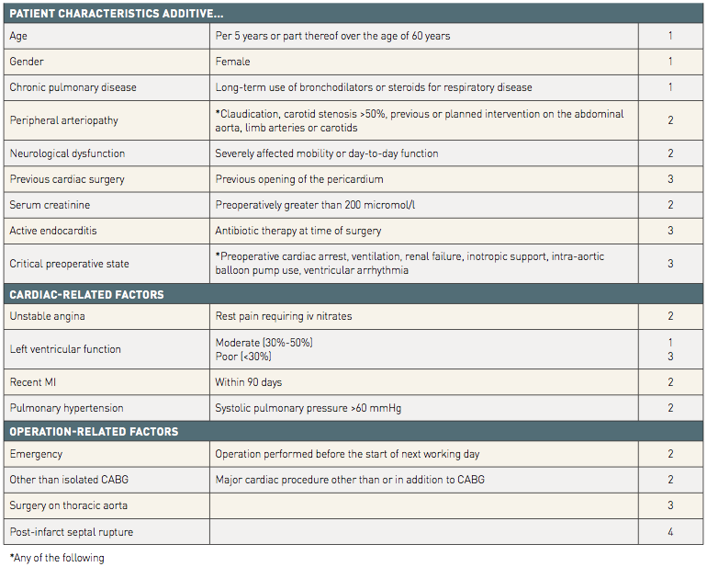

Risk stratification and risk models in revascularisation
Table 1
The components of the EuroSCORE and relevant weighting factors of the additive EuroSCOREs.
Hironori Hara, Kuniaki Takahashi, Vasim Farooq, David R. Holmes, Yoshinobu Onuma, Patrick W. Serruys
©2025 Europa Group - All rights reserved.

