Slide 1


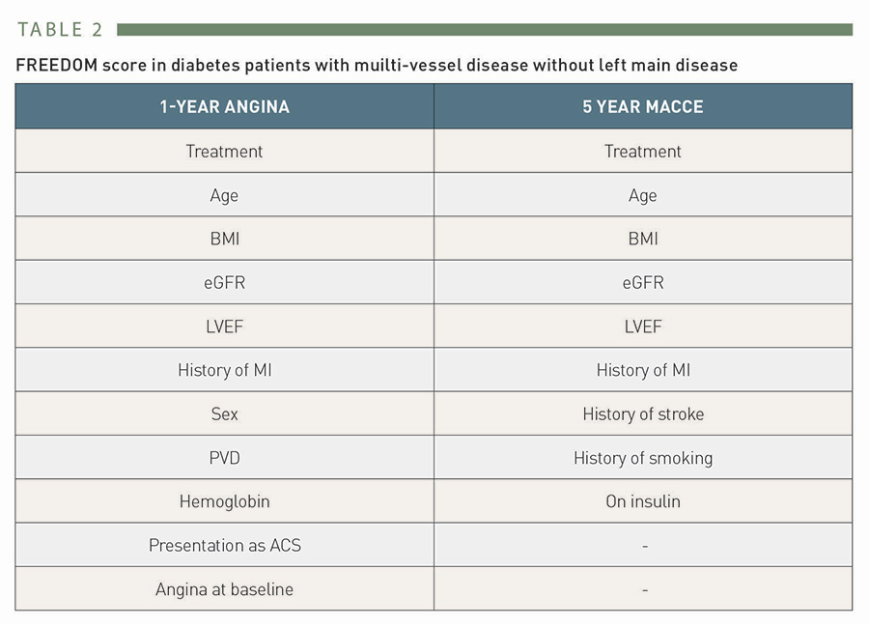

Risk stratification and risk models in revascularisation
Table 2
FREEDOM score in diabetes patients with muilti-vessel disease without left main disease.
Hironori Hara, Kuniaki Takahashi, Vasim Farooq, David R. Holmes, Yoshinobu Onuma, Patrick W. Serruys
©2025 Europa Group - All rights reserved.

