Slide 1


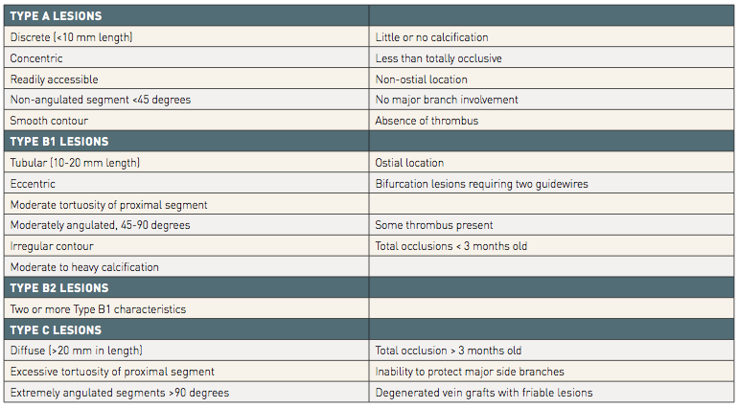

Risk stratification and risk models in revascularisation
Table 3
The criteria for Type A, B1, B2 and C lesions in the ACC/AHA lesion classification
Hironori Hara, Kuniaki Takahashi, Vasim Farooq, David R. Holmes, Yoshinobu Onuma, Patrick W. Serruys
©2025 Europa Group - All rights reserved.

