Slide 1


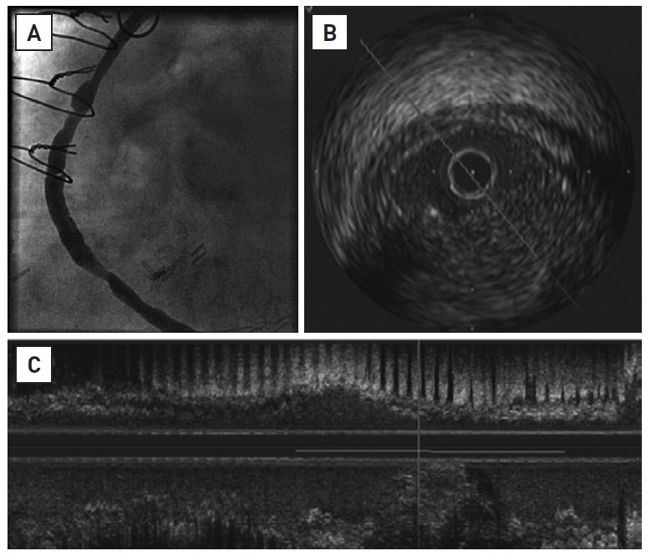

Saphenous vein graft disease
Figure 1
Old, degenerated saphenous vein graft to the right coronary artery Angiographic appearance of old vein graft (A). Intravascular ultrasound imaging showing cross section (B) and long run view (C). Diffuse, concentric, and predominantly hypoechogenic tissue with absence of fibrous cap and little evidence of calcification.
Gabriel Maluenda, Itsik Ben-Dor, Augusto D. Pichard
©2025 Europa Group - All rights reserved.

