Slide 1


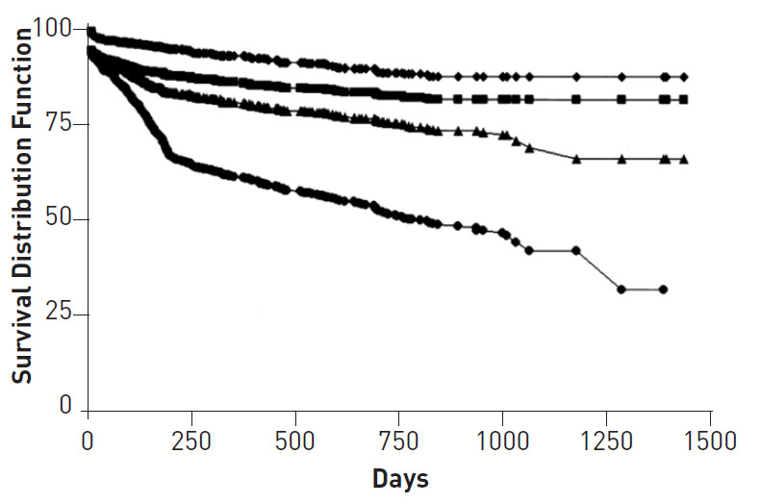
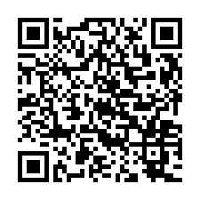
Saphenous vein graft disease
Figure 2
Total and event-free survival for patients after percutaneous revascularization of saphenous vein graftsSolid diamond = death; solid square = death, MI; solid triangle = death, MI, repeat CABG; solid circle = death, MI, any target vessel revascularization. CABG, coronary artery bypass graft surgery; MI, myocardial infarction.(Extracted from J Am Coll Cardiol 2001;38:659–65).
Gabriel Maluenda, Itsik Ben-Dor, Augusto D. Pichard
©2025 Europa Group - All rights reserved.

