Slide 1


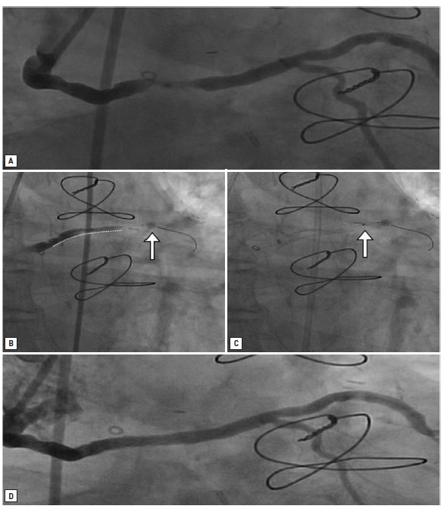

Saphenous vein graft disease
Figure 3
Distal “occlusion and aspiration” protection device in a saphenous vein graft interventionSevere stenosis in the mid-portion of a saphenous vein graft to the left circumflex coronary artery (A). Distal occlusion with noncompliant balloon (arrow) and stent positioned at the level of the lesion (white dotted line) (B). Manual debris aspiration (arrow indicates the tip of the aspiration catheter) with inflated distal occlusion balloon in place (C). Final angiographic result (D).
Gabriel Maluenda, Itsik Ben-Dor, Augusto D. Pichard
©2025 Europa Group - All rights reserved.

