Slide 1


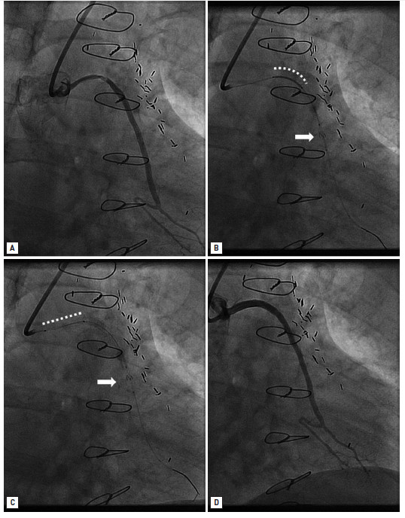

Saphenous vein graft disease
Figure 4
Distal filter in a saphenous vein graft interventionLong, severe, proximal stenosis of a saphenous vein graft to the left circumflex coronary artery (A). Distal filter (arrow) and first stent in place (white dotted line) (B). Distal filter (arrow) and second stent in place (white dotted line) (C). Final angiographic result (D).
Gabriel Maluenda, Itsik Ben-Dor, Augusto D. Pichard
©2025 Europa Group - All rights reserved.

