Slide 1


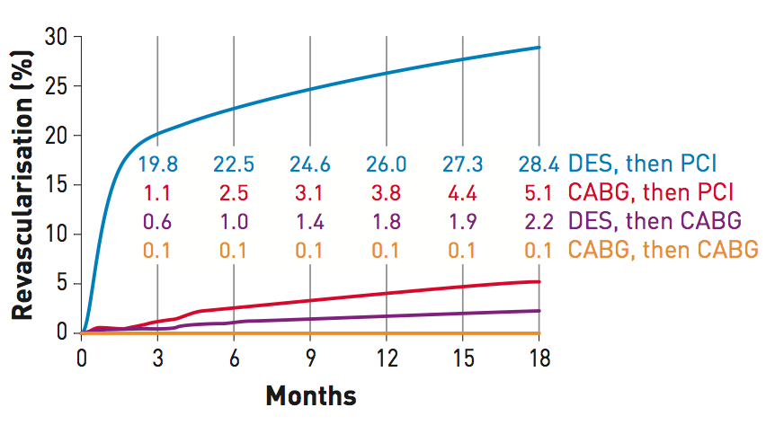

Secondary coronary revascularisation
Figure 1
Rates of secondary coronary revascularisationRates of secondary coronary revascularisation within 18 months after surgical (CABG, n=7,437) or percutaneous (PCI, n=9,963) primary coronary interventions in New York State between 2003 and 2004. Data corresponding to the 4 different modalities of secondary revascularisation is shown in different curves. By far, the most frequent modality of secondary revascularisation during this period was PCI after initial percutaneous revascularisation. This was followed by PCI after initial CABG. [From Hannan et al [4] with permission]
Hernan Mejia-Renteria, Nieves Gonzalo, Javier Escaned, Breda Hennessey
©2025 Europa Group - All rights reserved.

