Slide 1


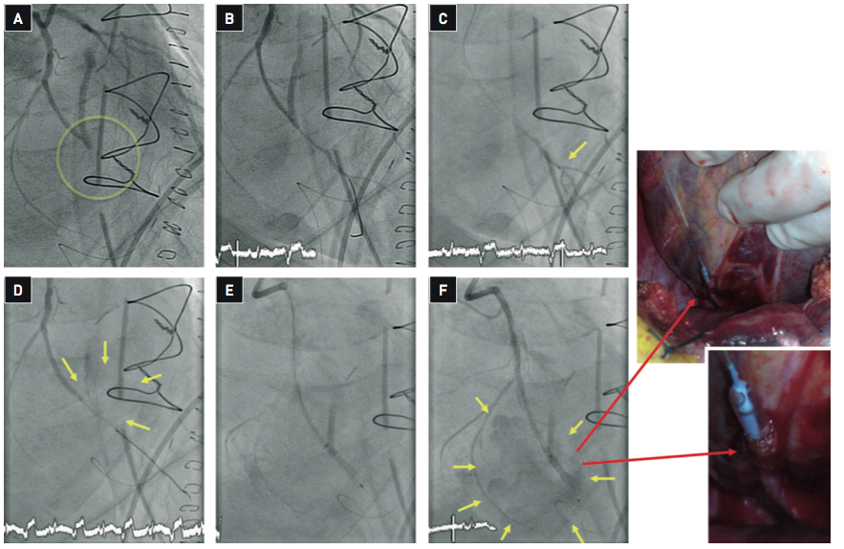

Secondary coronary revascularisation
Figure 10
Percutaneous intervention for early CABG failure Percutaneous intervention for early CABG failure has the intrinsic risk of working in recently manipulated vessels. This case illustrates the occurrence of complications in spite of a cautious approach. (A) Emergency angiography was performed in a patient with triple CABG 4 hours after surgery with the suspicion of acute closure of the saphenous vein graft implanted to the obtuse marginal (OM) branch. The vessel was diffusely diseased and surgical endartherectomy had been performed in the vessel distal to the anastomosis with the SVG graft. The OM branch was occluded and PCI through the native vessel was performed. (B) A guidewire over a Terumo FineCross intracoronary catheter was crossed through the occluded segment. (C) To verify a true intraluminal position of the guidewire, ruling out the possibility of an extravascular course through the fresh anastomosis, a distal injection through the microcatheter was performed. The distal vessel was adequately opacified. (D) Balloon dilation (2.0 mm balloon) of the occluded segment was immediately followed by important extravasation of contrast (yellow arrows) suggesting vessel rupture at the site of prior endartherectomy. Protamine was given to reverse anticoagulation. Attempts to seal the rupture with long balloon inflations (20 min) were unsuccessful. (E) A JoMed stent graft was advanced to the rupture site and implanted. Given the presence of proximal circumflex calcification, predilation was required to cross with the JoMed stent. (F) After deflation of the balloon massive bleeding to the pericardial space was documented (yellow arrows). The balloon was inflated to stop bleeding and the patient was transferred to the surgical theatre. The images taking in the surgical theatre show the extravascular location of the distal aspect of the JoStent (red arrows). Surgical repair and re-grafting was performed. The most likely explanation for this complication is that, in spite of prior verification of the intraluminal position of the guidewire, the wire went extravascular during the manoeuvring required for the passage of the stent graft.
Hernan Mejia-Renteria, Nieves Gonzalo, Javier Escaned, Breda Hennessey
©2025 Europa Group - All rights reserved.

