Slide 1


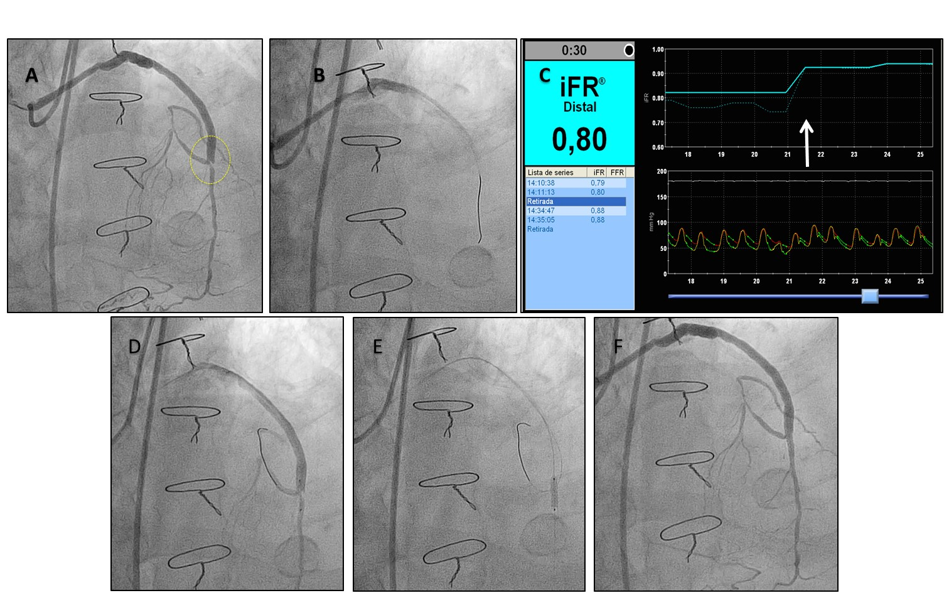

Secondary coronary revascularisation
Figure 11
iFR-guided revascularisation of a stenosis located at the coronary anastomosis of a saphenous vein graft. A. The panel shows a left anterior descending artery (LAD), with prior chronic total occlusion treated with insertion of a saphenous vein graft 7 years before. The graft was patent and without diffuse disease, but presented a stenosis at the distal anastomosis (yellow circle). B. Functional assessment with pressure wire (iFR mapping) was performed to assess the haemodynamic relevance of the stenosis and the contribution of distal irregularities in the LAD to pressure drop. C. The estimated iFR was 0.80 in the mid LAD segment, indicating that the stenosis was haemodynamically severe. The pressure wire was pulled back demonstrating that the pressure gradient was located at the anastomosis lesion (white arrow), ruling out the contribution of diffuse LAD narrowing to impaired coronary conductance. D, E. PCI was performed through the functional graft and limited to the stenosis located at the anastomosis. An additional wire was used to protect the segment of the LAD proximal to the anastomosis. A drug eluting stent was successfully deployed. Taking into account the difference in diameter between SVG and the native vessel, the proximal portion of the stent was post-dilatated with a larger balloon, with a good final result (F).
Hernan Mejia-Renteria, Nieves Gonzalo, Javier Escaned, Breda Hennessey
©2025 Europa Group - All rights reserved.

