Slide 1


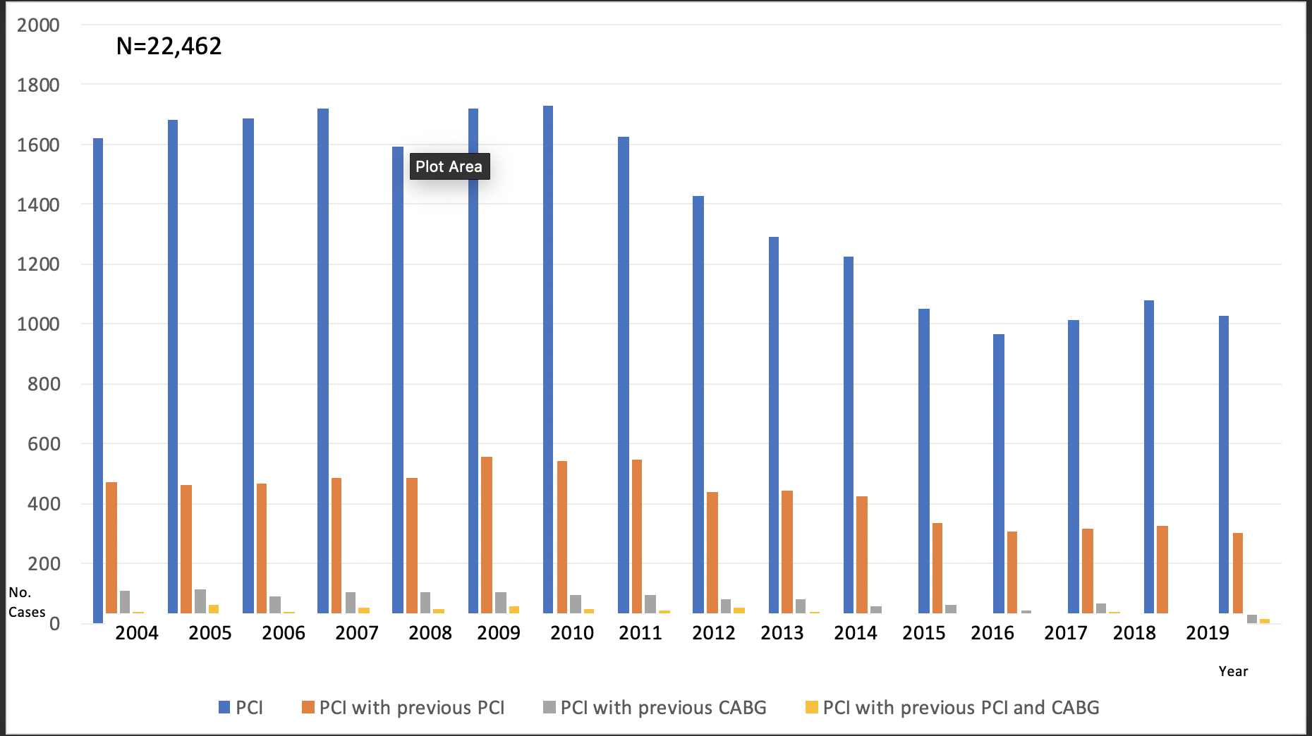

Secondary coronary revascularisation
Figure 2
Trends in percutaneous revascularisation Institutional trends in percutaneous revascularisation, as reflected by 22,426 percutaneous revascularisation (PCI) procedures performed at a European centre (Hospital Clinico San Carlos) between 1985 and 2009. The approximate date when relevant developments in PCI were introduced is displayed below the graphic. The percentage of patients with prior interventions (surgical or percutaneous) undergoing PCI remains pretty stable since 1990, being 34% within the last 4 years. The last lustrum is incomplete, and only a 4-year period is shown (hence the arrows predicting figures by the 5th year). POBA: plain old balloon angioplasty; BMS: bare metal stents; EPD: embolic protection devices; DES: drug eluting stents; AD: aspiration devices. [From Escaned J [1] with permission]
Hernan Mejia-Renteria, Nieves Gonzalo, Javier Escaned, Breda Hennessey
©2025 Europa Group - All rights reserved.

