Slide 1


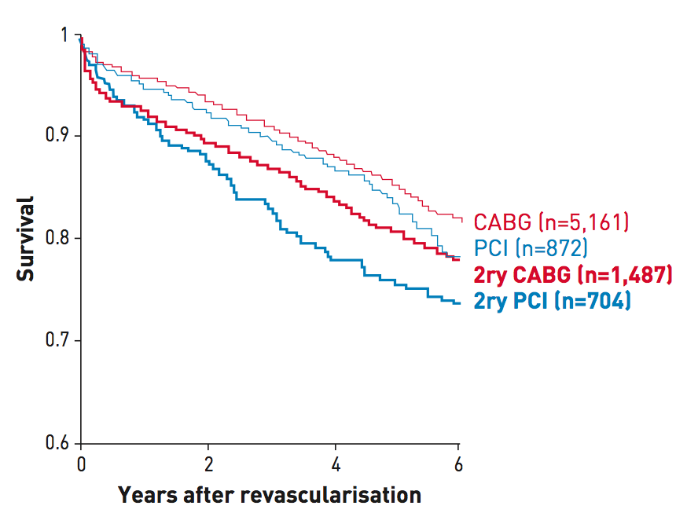

Secondary coronary revascularisation
Figure 3
Survival curves from PCI and CABG cohorts after primary multivessel revascularisation and secondary revascularisation Unadjusted survival curves from PCI and CABG cohorts after primary multivessel revascularisation (CABG and PCI, thin lines) and secondary revascularisation (reCABG and rePCI, thicker lines) from a large volume centre, showing the poorer outcome of patients undergoing secondary revascularisation, irrespective of the technique used. The graphic has been built by merging data from two separate reports from the same institution (Brener SJ et al. Circulation. 2004;109:2290-5 and Brener SJ et al. Eur Heart J. 2006;27:413-8.). The number of patients included in each cohort is shown between brackets. 2ry: secondary revascularisation. [From Escaned J [1] with permission]
Hernan Mejia-Renteria, Nieves Gonzalo, Javier Escaned, Breda Hennessey
©2025 Europa Group - All rights reserved.

