Slide 1


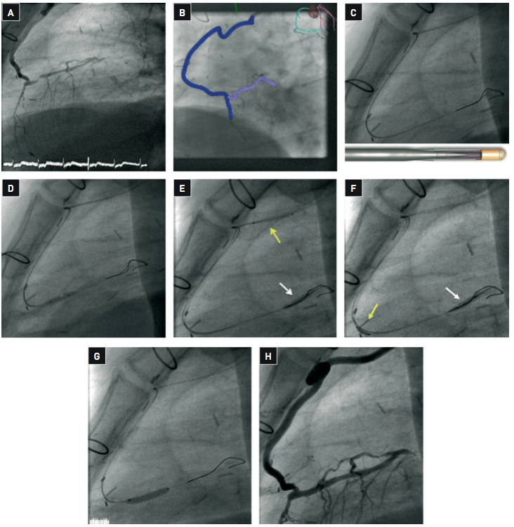

Secondary coronary revascularisation
Figure 4
Percutaneous revascularisation of a native LAD stenosis located upstream the anastomosis of a very tortuous ITA graft (A) TheLAD was occluded in its proximal segment. The patient presented chronic renal failure with creatinine clearance of 45 ml/min. (B) The procedure was performed using magnetic navigation (Stererotaxis) in order to facilitate guidewire advancement through this complex anatomy and reducing contrast administration to a minimum. A Constellation 3D vessel reconstruction was performed to modulate the magnetic field during the procedure. (C) Two magnet-tipped Pegasus guidewires (shown in the lower part of the illustration) were advanced using the 3D vessel reconstruction and magnetic navigation. The second magnet-tipped Pegasus guidewire was used to perform a reverse trapping technique. Using a Terumo Finecross® microcatheter, one of then Pegasus guidewire was exchanged for a Asahi GrandSlam guidewire. (D) Balloon dilation was then performed. (E-F) The balloon was then further advanced upstream and inflated to trap the second Pegasus guidewire (white arrow) and a Biosensor BioMatrix™ 2.5x12 mm stent (yellow arrow) was then advanced over the trapped guidewire. This allowed successful positioning of the prosthesis at the stenotic site. (G) Withdrawal of the GrandSlam guidewire was then performed over a microcatheter (white arrows) to prevent damage of the sharp vessel bends by the guidewire, and the stent was deployed. (H) An excellent angiographic result was obtained. The total amount of contrast medium used in the procedure was 93 ml. The patient evolved favourably without evidence of contrast-induced nephropathy. [Case courtesy of Javier Escaned, Hospital Clinico San Carlos, Madrid, Spain]
Hernan Mejia-Renteria, Nieves Gonzalo, Javier Escaned, Breda Hennessey
©2025 Europa Group - All rights reserved.

