Slide 1


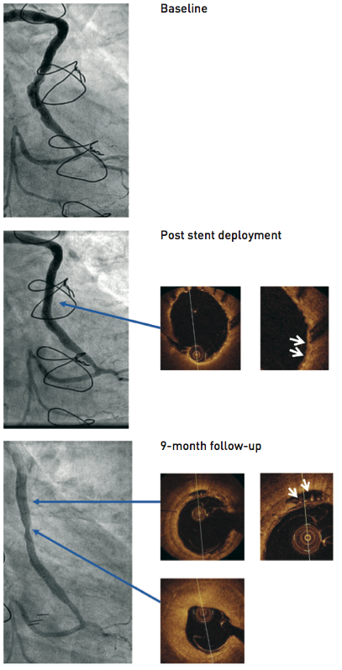

Secondary coronary revascularisation
Figure 6
Percutaneous treatment of a degenerated aortocoronary saphenous vein graft anastomosed to the obtuse marginal branch A PET-mesh covered stent (MGuard) was implanted with concomitant use of a FilterWire distal embolic protection device. The angiographic images obtained before, immediately after PCI and at 9-month follow-up are shown. Optical coherence imaging immediately after the procedure shows embedment of the stent struts in the soft friable atheroma and the scaffolding effect of the PET mesh. At follow-up the patient was asymptomatic, and non-invasive testing did not disclosed myocardial ischaemia. There was localised luminal loss inside the stent, causing a non-significant stenosis. Intracoronary imaging with OCT demonstrated heterogeneous vascular responses to the implantation of the stent, with predominant neointimal hyperplasia at the site of minimal luminal diameter and localised areas of late appearing stent malaposition in angiographically normal segments. The thin PET filaments are visible within these areas of malaposition. [Case courtesy of Eulogio García, Hospital Clinico San Carlos, Madrid, Spain]
Hernan Mejia-Renteria, Nieves Gonzalo, Javier Escaned, Breda Hennessey
©2025 Europa Group - All rights reserved.

