Slide 1


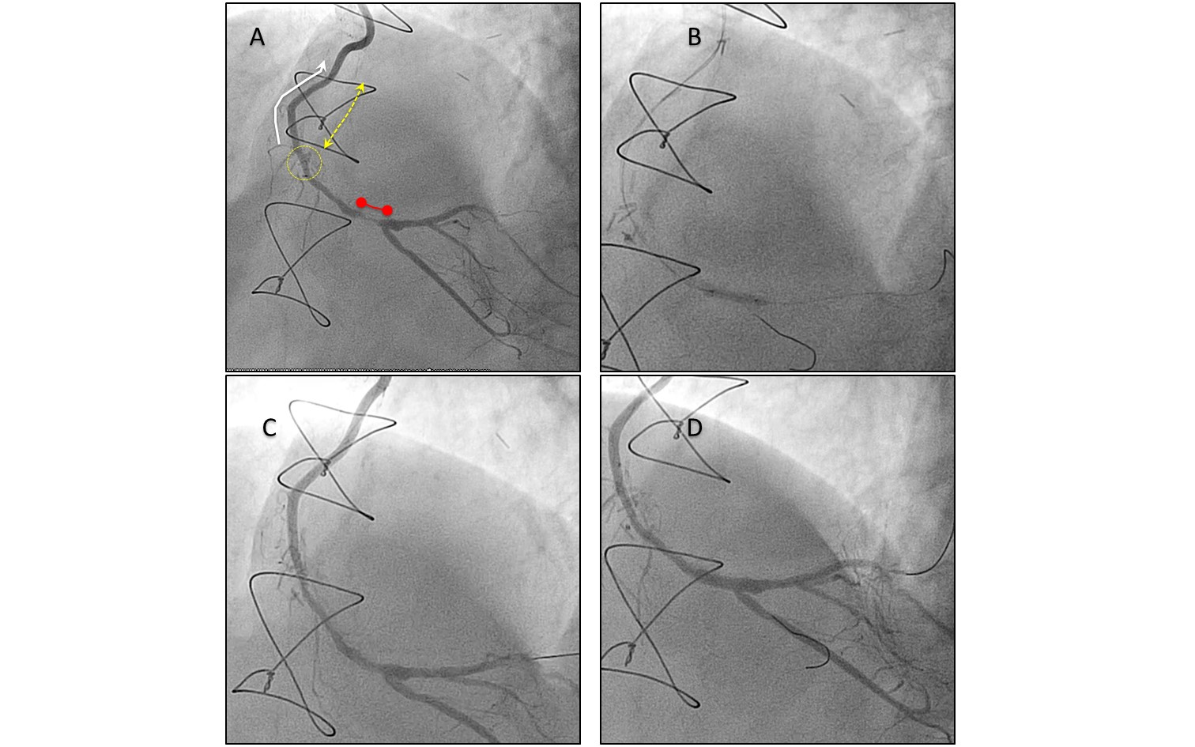

Secondary coronary revascularisation
Figure 7
Percutaneous treatment of native vessel disease progression distal to an arterial graft
A. The figure shows an occluded proximal-mid right coronary artery (RCA) (dotted yellow arrow shows the occluded segment), treated previously with an internal thoracic artery graft (white arrow). Progression of disease of the native vessel (red segment) occurred distal to the graft anastomosis (yellow circle). The graft was patent, without obstructive disease. B. On the grounds of maintaining future graft patency, PCI was performed to the native vessel through the functional graft. Two wires were crossed to protect the bifurcation with the posterior descending artery. C. The stenosis was pre-dilatated with balloon, with good result. D. A drug eluting stent was deployed from the distal RCA to the posterolateral branch using a provisional stent technique, with a good final result .
Hernan Mejia-Renteria, Nieves Gonzalo, Javier Escaned, Breda Hennessey
©2025 Europa Group - All rights reserved.

