Slide 1


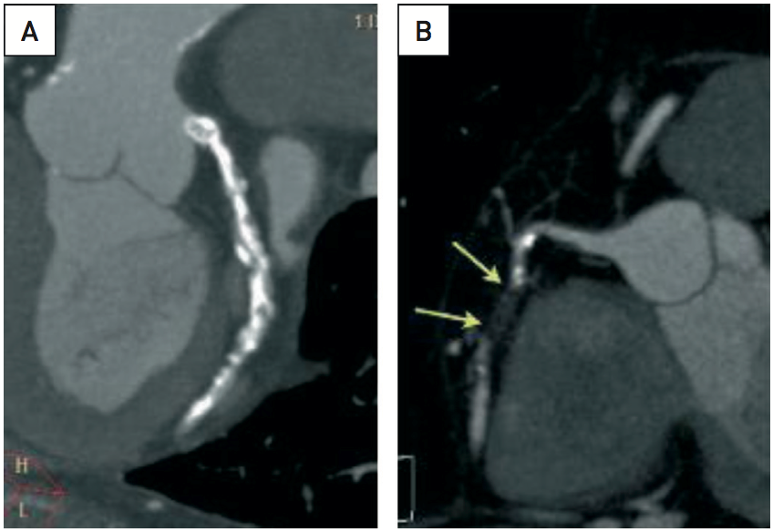

Secondary coronary revascularisation
Figure 8
The added value of multislice computed tomography imaging in planning secondary revascularisation on native coronary vessels after CABG (A) Modified coronal view using multiplanar reconstruction (MPR) with maximal intensity projection (MIP) of the left circumflex artery (LCX) in a patient with previous CABG, patent LIMA graft to LAD, occluded SVG to OM1, COPD and effort angina. Note the heavily calcified native LCX which makes the use of rotational atherectomy in treating the OM mandatory. (B) Modified lateral view with MPR and MPI reconstruction of the axial stack acquired with 64-row MDCT of an occluded RCA in a patient with prior CABG with stable angina. The RCA was patent at the time of CABG and was not grafted. Distal replenishment by collateral circulation allows an accurate assessment of the length of the occlusion. A right ventricular branch is present immediately after the end of the occlusion. The occluded segment is short, has no calcium (there is moderate calcification immediately before and after the occlusion) and follows a straight course, without bends. These are favourable features for the purpose of percutaneous recanalisation of the RCA
Hernan Mejia-Renteria, Nieves Gonzalo, Javier Escaned, Breda Hennessey
©2025 Europa Group - All rights reserved.

