Slide 1


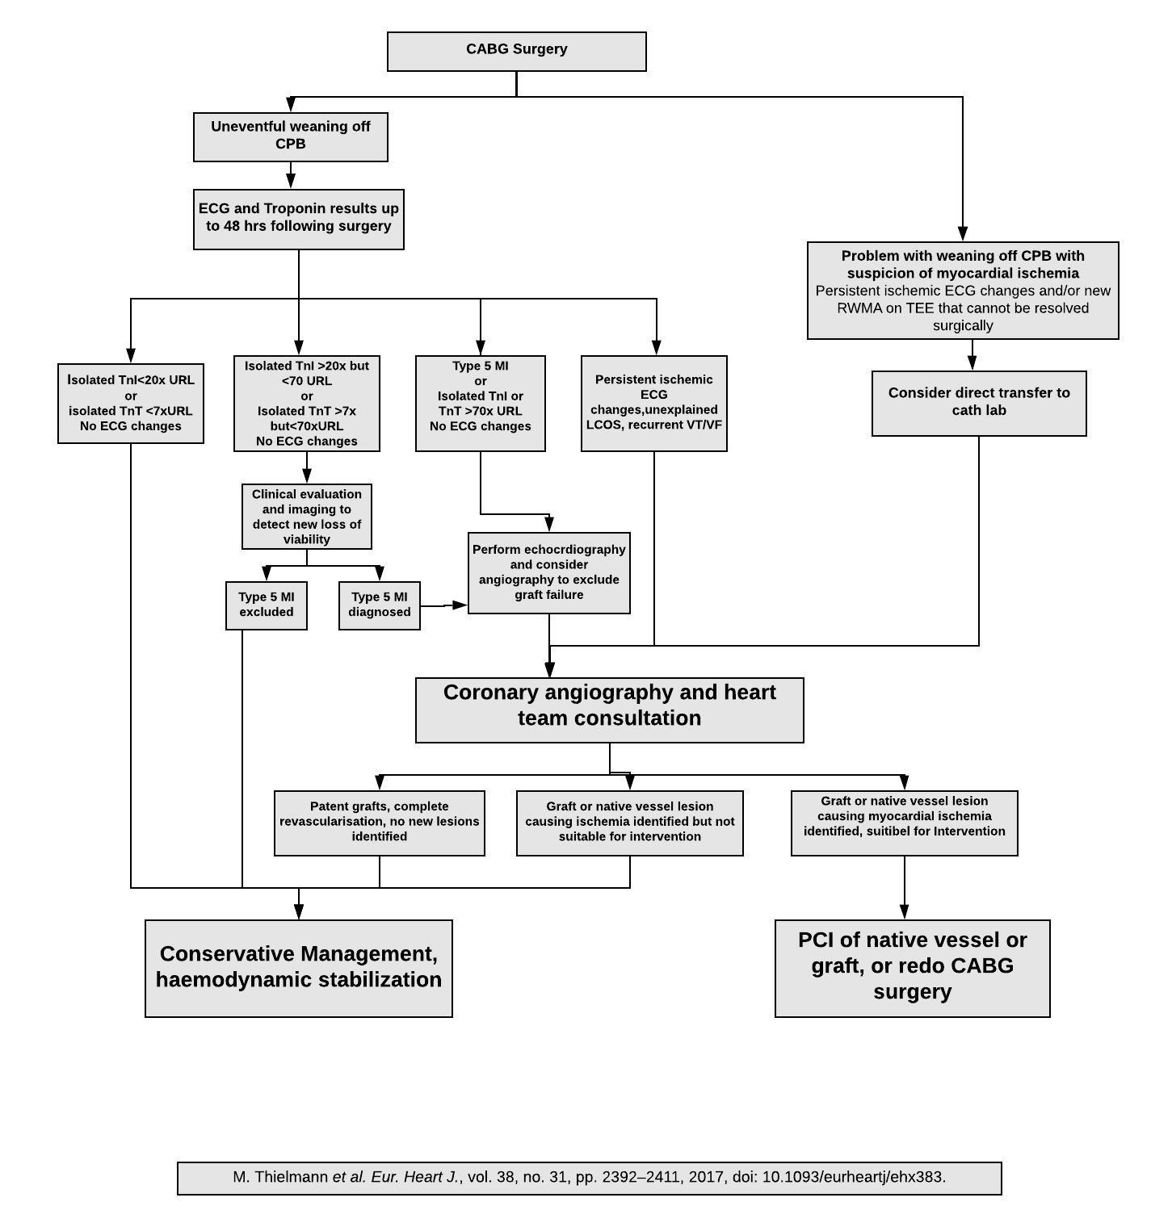

Secondary coronary revascularisation
Figure 9
A suggested algorithm for the management of early CABG failure.
Hernan Mejia-Renteria, Nieves Gonzalo, Javier Escaned, Breda Hennessey
©2025 Europa Group - All rights reserved.

