Slide 1


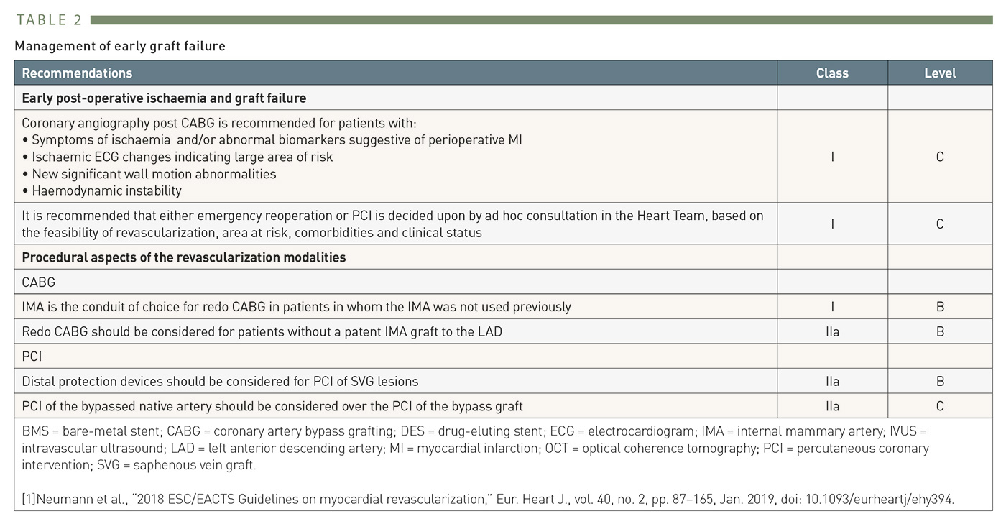

Secondary coronary revascularisation
Table 2
2014 ESC Guidelines recommendations for secondary revascularisation after early CABG failure
Hernan Mejia-Renteria, Nieves Gonzalo, Javier Escaned, Breda Hennessey
©2025 Europa Group - All rights reserved.

