Slide 1


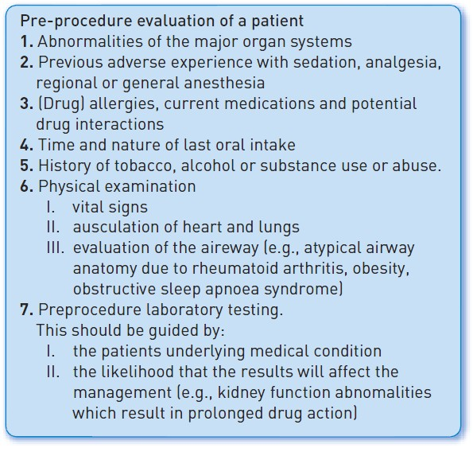

Sedation, pain management and resuscitation
Figure 1
A pre-procedure evaluation of a patient consists of (knowledge of) these items
Astrid van Nieuwkerk, Ronak Delewi
©2025 Europa Group - All rights reserved.

