Slide 1


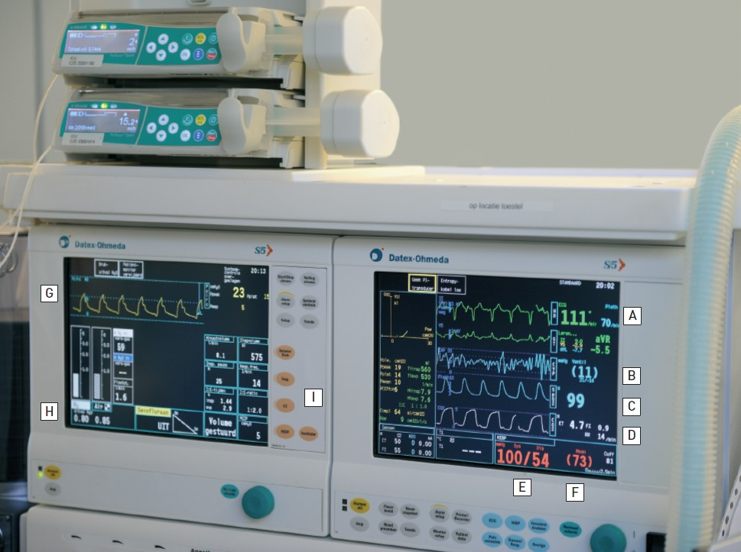

Sedation, pain management and resuscitation
Figure 2
Advanced monitoringThe monitors display all the essential cardio-respiratory parameters during a procedure:(A) ECG monitor. (B) Central venous pressure. (C) Arterial oxygen saturation. (D) Capnograph measuring end-tidal-CO2. (E) Arterial blood pressure. (F) Mean arterial blood pressure. (G)Ventilatory pressure. (H) Inspiratory Oxygen Fraction (FIO2). (I) Respiratory mode with ventilator settings (volume, frequency, PEEP).
Astrid van Nieuwkerk, Ronak Delewi
©2025 Europa Group - All rights reserved.

