Slide 1


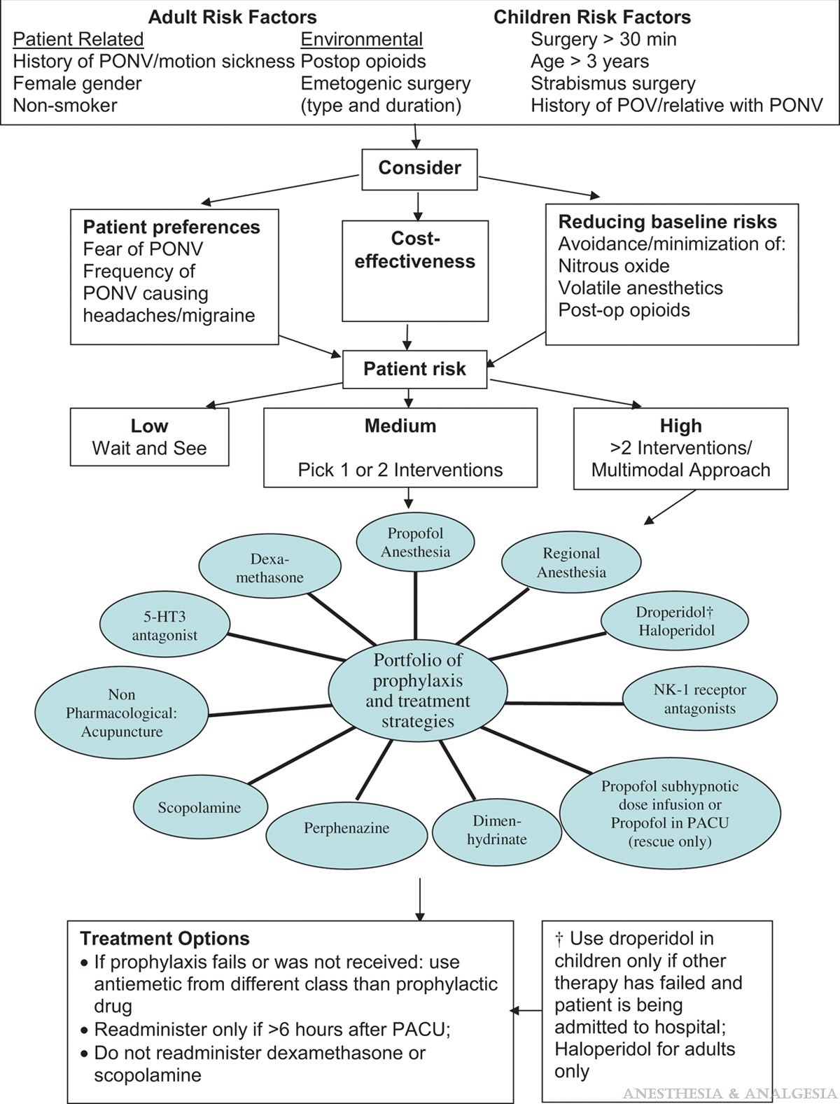

Sedation, pain management and resuscitation
Figure 3
Proposed treatment regimen for local anaesthestic toxicity using IVLE
Astrid van Nieuwkerk, Ronak Delewi
©2025 Europa Group - All rights reserved.

