Slide 1


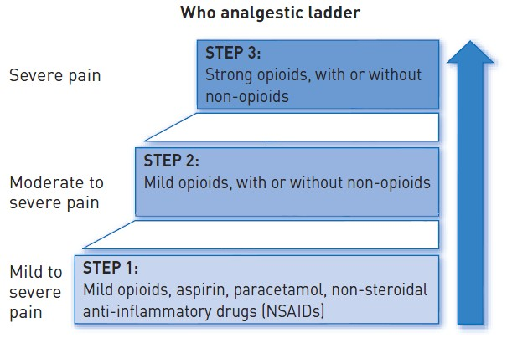
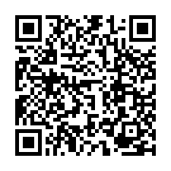
Sedation, pain management and resuscitation
Figure 4
World Health Organisation Analgesic (Pain Relief) Ladder
Astrid van Nieuwkerk, Ronak Delewi
©2025 Europa Group - All rights reserved.

