Slide 1


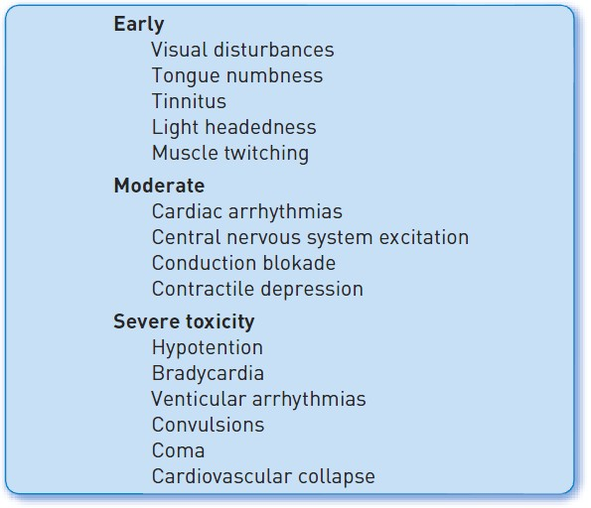

Sedation, pain management and resuscitation
Figure 5
Possible signs and symptoms of local anaesthetic toxicity
Astrid van Nieuwkerk, Ronak Delewi
©2025 Europa Group - All rights reserved.

