Slide 1


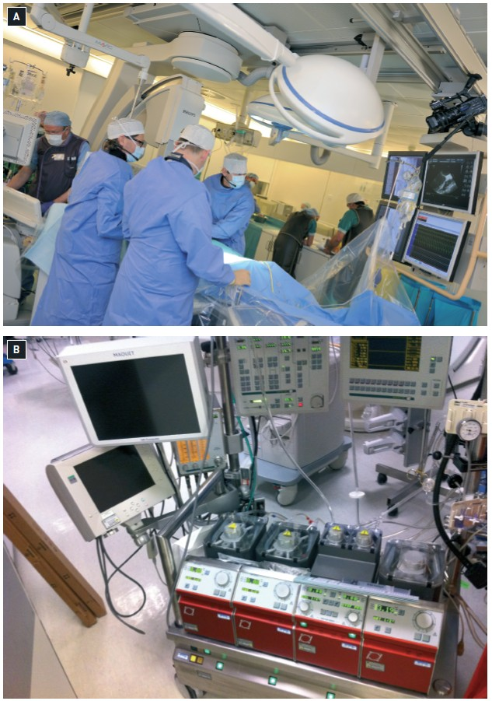

Sedation, pain management and resuscitation
Figure 7
(A) Hybrid laboratory; (B) Cardiopulmonary bypass equipment
Astrid van Nieuwkerk, Ronak Delewi
©2025 Europa Group - All rights reserved.

