Slide 1


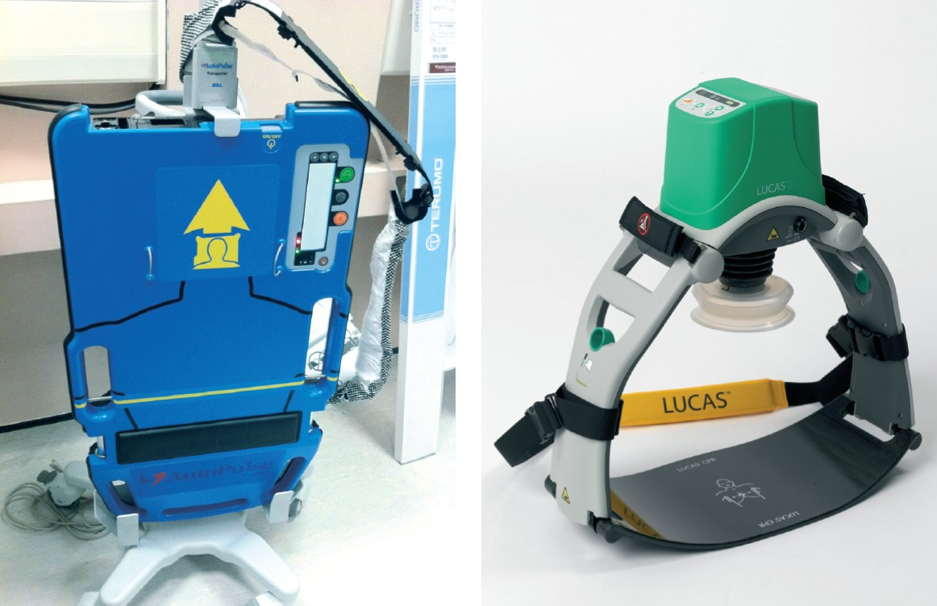

Sedation, pain management and resuscitation
Figure 8
Mechanical chest compression devices
Astrid van Nieuwkerk, Ronak Delewi
©2025 Europa Group - All rights reserved.

