Slide 1


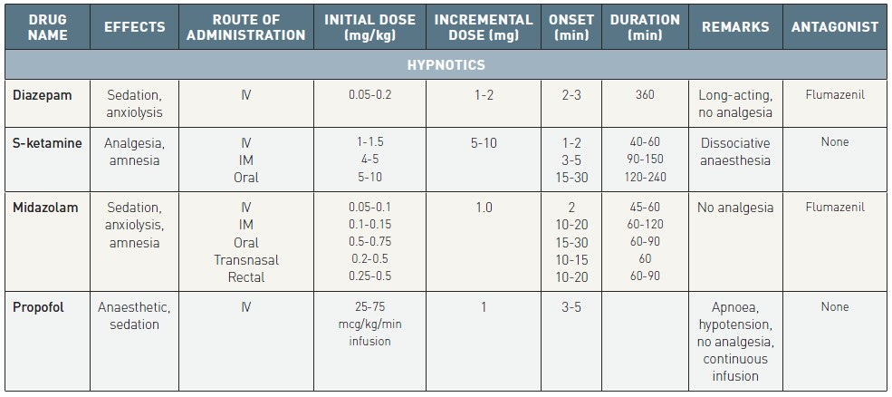

Sedation, pain management and resuscitation
Table 1
Characteristics of commonly used hypnotics
Astrid van Nieuwkerk, Ronak Delewi
©2025 Europa Group - All rights reserved.

