Slide 1


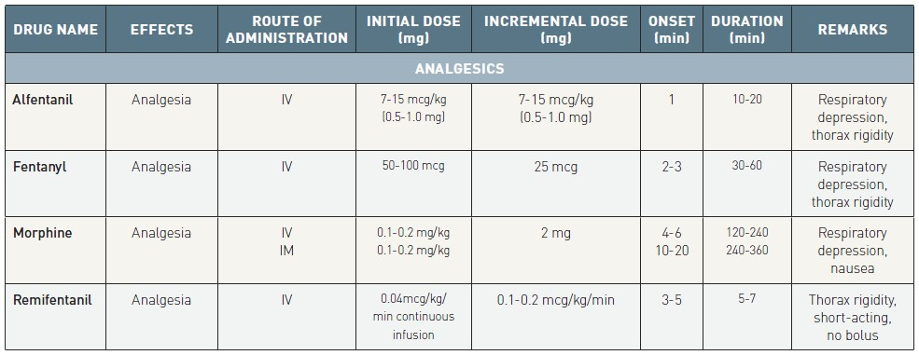

Sedation, pain management and resuscitation
Table 2
Characteristics of commonly used analgesics
Astrid van Nieuwkerk, Ronak Delewi
©2025 Europa Group - All rights reserved.

