Slide 1

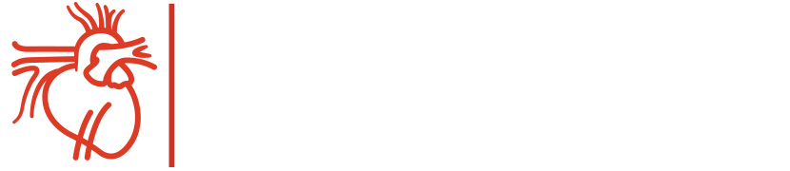
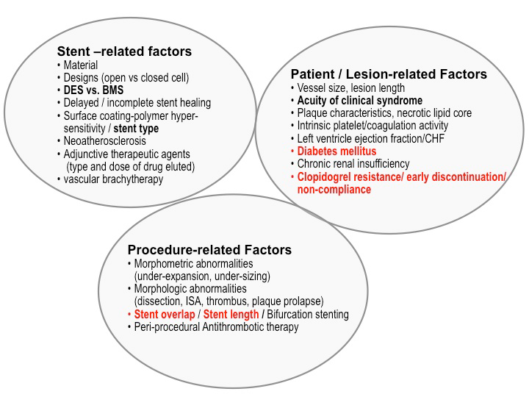
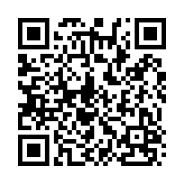
Stent thrombosis (old)
Figure 1
Factors associated with the occurrence of stent thrombosis.BMS: bare metal stent; CHF: congestive heart failure; DES: drug-eluting stent; ISA: incomplete stent strut apposition; LVEF: left ventricular ejection fraction. Reprinted with permission of MedReviews®, LLC. Kereiakes DJ. Safety of drug-eluting stents. Rev Cardiovasc Med. 2010;11:186-200.
Dean J. Kereiakes, Ian J. Sarembock
©2025 Europa Group - All rights reserved.

