Slide 1


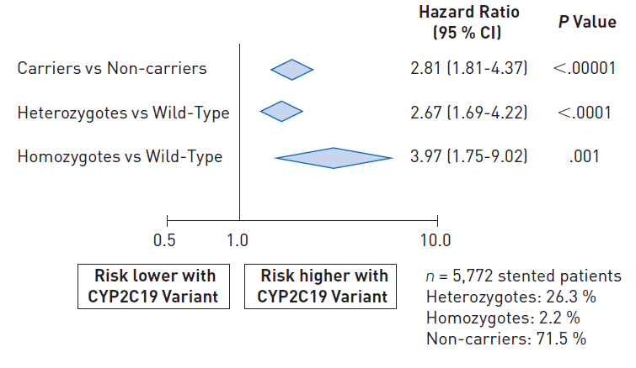

Stent thrombosis (old)
Figure 10
Collaborative meta-analysis involving 9,685 patients demonstrating the relationship between hepatic CYP2C19 loss of function allele status and risk for stent thrombosis in patients treated with clopidogrel following coronary stent deployment. A gene-dose response for risk of stent thrombosis is evident with greatest risk (hazard ratio ~4.0) present in homozygotes.[Adapted with permission from Mega et al JAMA. 2010;304:1821-30]
Dean J. Kereiakes, Ian J. Sarembock
©2025 Europa Group - All rights reserved.

