Slide 1


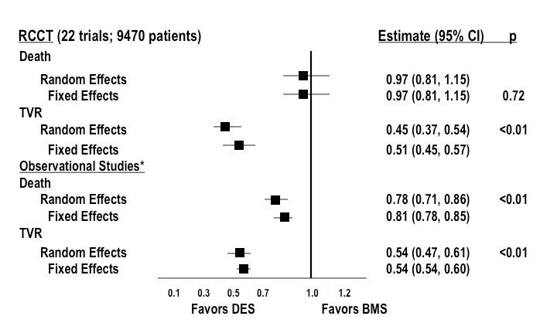

Stent thrombosis (old)
Figure 2
Meta-analysis of randomised controlled clinical trials (RCCT) and observational studies demonstrating the relative benefit of drug eluting (DES) versus bare metal stents (BMS) on the clinical endpoints of target vessel revascularisation (TVR) or death. DES reduce TVR to a similar degree in both RCCT and observational studies. DES are associated with either no difference (RCCT) or a reduction in death (observational studies) compared with BMS. HR: hazard ratio; CI: confidence intervals. *34 studies including 182,901 patients. Adapted with permission from Kirtane et al. Circulation. 2009;119:3198-3206.
Dean J. Kereiakes, Ian J. Sarembock
©2025 Europa Group - All rights reserved.

