Slide 1


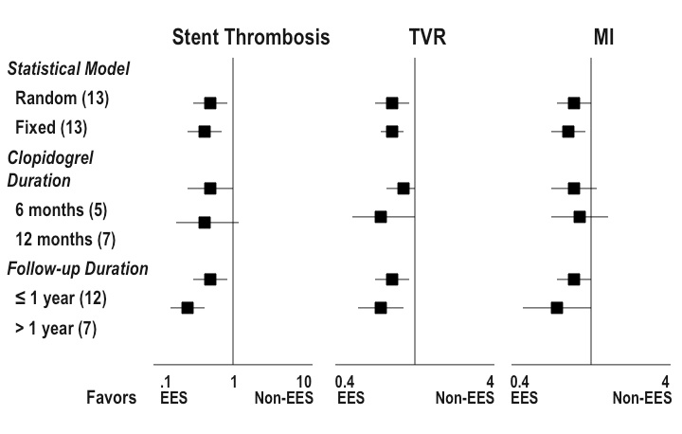

Stent thrombosis (old)
Figure 3
Meta-analysis of 13 randomized controlled clinical trials involving 17,097 patients comparing multiple drug-eluting stent (DES) types. Stent thrombosis, target vessel revascularisation (TVR) and myocardial infarction (MI) were consistently reduced by everolimus-eluting stents (EES) when compared with all other non-EES DES included in analysis. The benefit of EES appears to be present regardless of either clopidogrel treatment or follow-up duration. Adapted with permission from Baber et al. J Am Coll Cardiol. 2011;58:1569-1577.
Dean J. Kereiakes, Ian J. Sarembock
©2025 Europa Group - All rights reserved.

