Slide 1


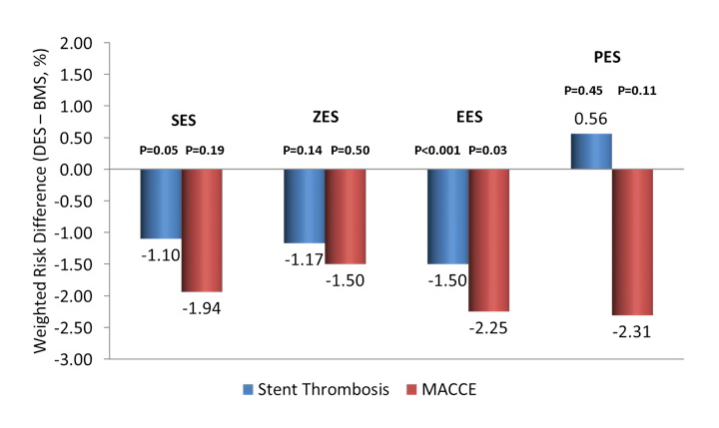

Stent thrombosis (old)
Figure 4
Weighted risk differences for stent thrombosis and major adverse cardiovascular and cerebrovascular events (MACCE; death, myocardial infarction, stroke) by individual drug-eluting stent (DES) type with their propensity matched bare metal stent cohort. The risk difference favoring DES for MACCE is apparent across DES subtypes. The risk difference for stent thrombosis is present for all DES except the paclitaxel-eluting stent (PES). EES: everolimus-eluting stent; SES: sirolimus-eluting stent; PES: paclitaxel-eluting stent; ZES: zotarolimus-eluting stent (Endeavor). From Kereiakes et al. AHA 2014 abstract presentation 11/18/2014; http://my.americanheart.org/idc/groups/ahamah-public/@wcm/@sop/@scon/documents/downloadable/ucm_469644.pdf
Dean J. Kereiakes, Ian J. Sarembock
©2025 Europa Group - All rights reserved.

