Slide 1


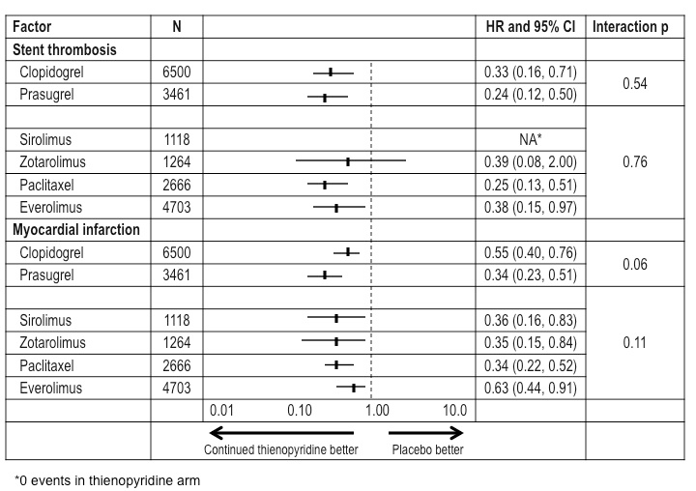
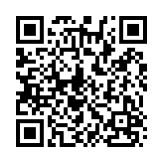
Stent thrombosis (old)
Figure 5
Consistency of treatment effect for stent thrombosis and myocardial infarction (12-3 months) by drug and drug-eluting stent type. Consistency of treatment benefit for stent thrombosis was observed.
Dean J. Kereiakes, Ian J. Sarembock
©2025 Europa Group - All rights reserved.

