Slide 1


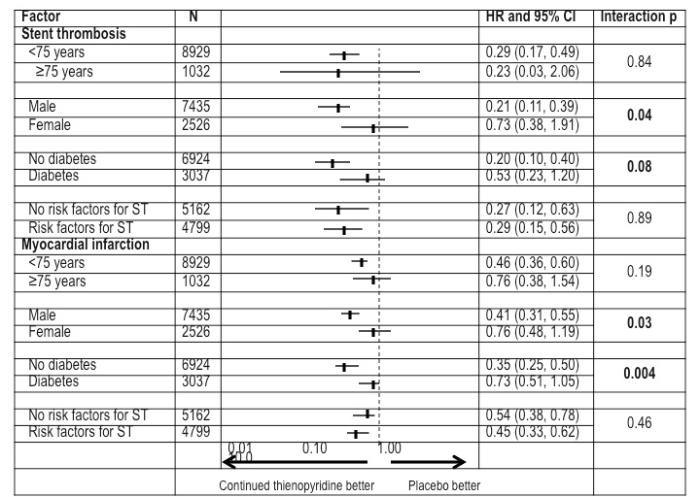

Stent thrombosis (old)
Figure 6
Consistency of treatment effect for stent thrombosis and myocardial infarction (12-30 months) by subgroup. Although all groups derived benefit of longer (30 months) thienopyridine therapy, the relative benefit was greater amongst men and subjects without diabetes. Treatment effect benefit was similar in subjects both with and without pre-defined risk factors for stent thrombosis.
Dean J. Kereiakes, Ian J. Sarembock
©2025 Europa Group - All rights reserved.

