Slide 1


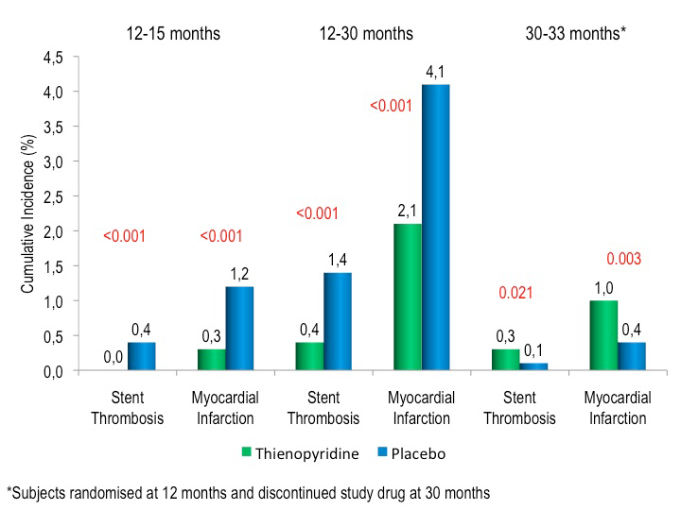

Stent thrombosis (old)
Figure 7
Stent thrombosis and myocardial infarction during the primary analysis period (12-30m) and following study drug discontinuation (30-33 months). The randomised study drug treatment (thienopyridine vs placebo) was administered during months 12-30. During months 12-15, an increased ischaemic risk was observed for patients randomised to placebo as thienopyridine therapy was withdrawn. During months 30-33, increased risk was observed for patients randomised to extended thienopyridine therapy as thienopyridine was withdrawn. All subjects received aspirin.Adapted with permission from Yeh et al. J Am Coll Cardiol 2015 (in press).
Dean J. Kereiakes, Ian J. Sarembock
©2025 Europa Group - All rights reserved.

