Slide 1


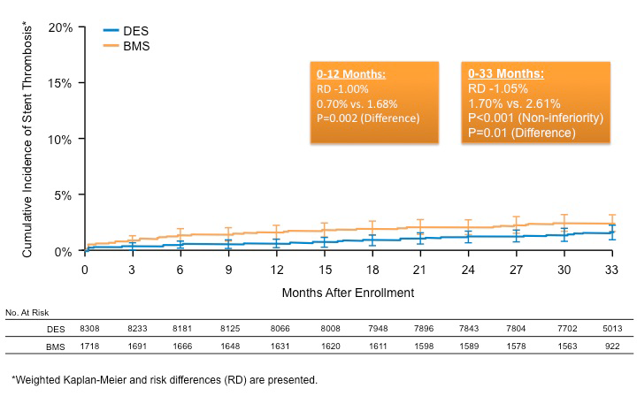

Stent thrombosis (old)
Figure 8A
Cumulative incidence of primary outcomes in propensity-matched drug-eluting or bare metal stent-treated subjects.Weighted Kaplan-Meier curves for cumulative incidence of stent thrombosis (A) and major adverse cardiovascular and cerebrovascular events (MACCE)From Kereiakes et al. AHA 2014 abstract presentation 11/18/2014; http://my.americanheart.org/idc/groups/ahamah-public/@wcm/@sop/@scon/documents/downloadable/ucm_469644.pdf
Dean J. Kereiakes, Ian J. Sarembock
©2025 Europa Group - All rights reserved.

