Slide 1


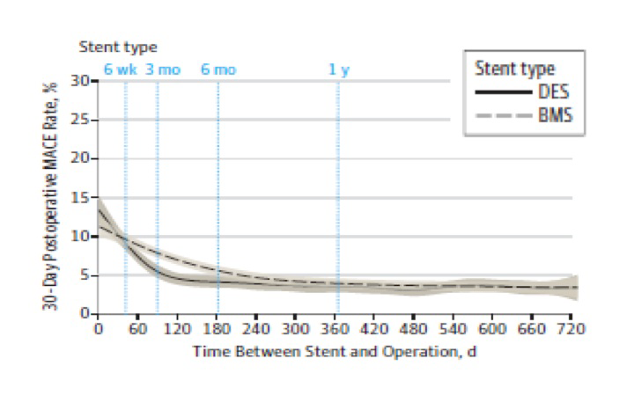

Stent thrombosis (old)
Figure 9
Major adverse cardiovascular events (MACE; death, myocardial infarction, repeat revascularisation) following non-cardiac surgery by time duration after coronary artery stenting.The adjusted odds ratio for MACE is 0.75 (95% confidence interval) [0.62, 0.91] favouring drug eluting stents (DES) versus bare metal stents (BMS) between 6 weeks and 6 months following stent deployment.With permission from Hawn et al. JAMA 2013;310:1462-1472.
Dean J. Kereiakes, Ian J. Sarembock
©2025 Europa Group - All rights reserved.

