Slide 1


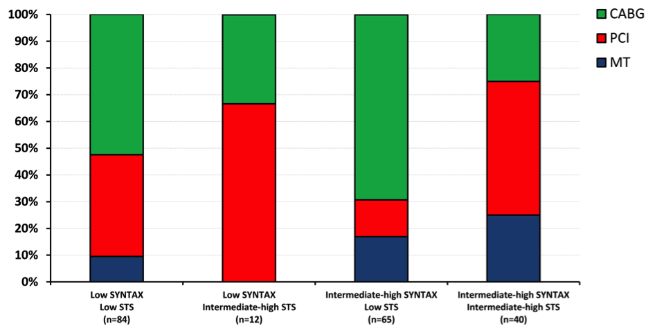

The Heart team (old)
Figure 4
Relationship between Heart Team decision and risk scores
Data from Sanchez et al. [26701]. CABG = coronary artery bypass grafting; MT = medical therapy; PCI = percutaneous coronary intervention.
Stuart J. Head, Nicolas M. Van Mieghem, Patrick W. Serruys, Victor Arevalos
©2025 Europa Group - All rights reserved.

