Slide 1


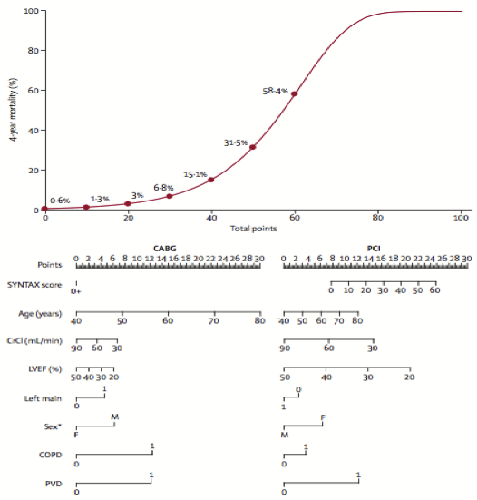
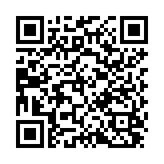
The Heart team (old)
Figure 5
SYNTAX 2 Nomogram
Stuart J. Head, Nicolas M. Van Mieghem, Patrick W. Serruys, Victor Arevalos
©2025 Europa Group - All rights reserved.

