Slide 1


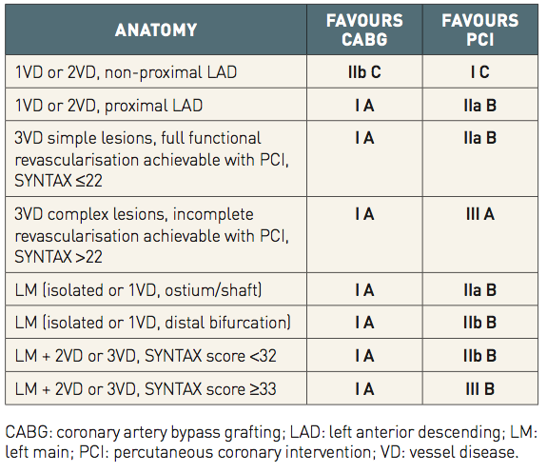
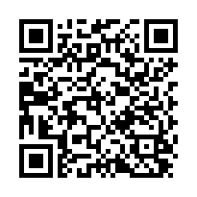
The Heart team (old)
Table 1
ESC/EACTS guidelines on myocardial revascularisation in stable patients [Adapted from ESC/EACTS guidelines [23]]
Stuart J. Head, Nicolas M. Van Mieghem, Patrick W. Serruys, Victor Arevalos
©2025 Europa Group - All rights reserved.

