Slide 1


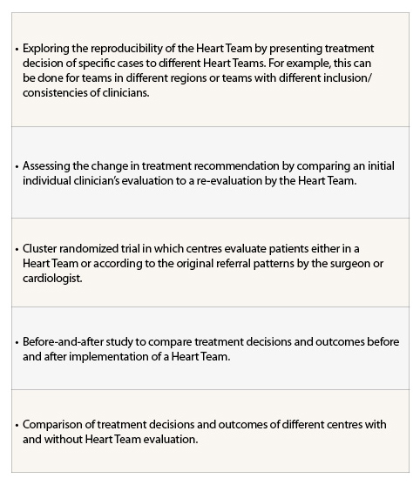
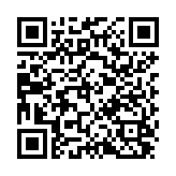
The Heart team (old)
Table 2
Possible study designs to validate and evaluate the Heart Team concept
Stuart J. Head, Nicolas M. Van Mieghem, Patrick W. Serruys, Victor Arevalos
©2025 Europa Group - All rights reserved.

