Slide 1


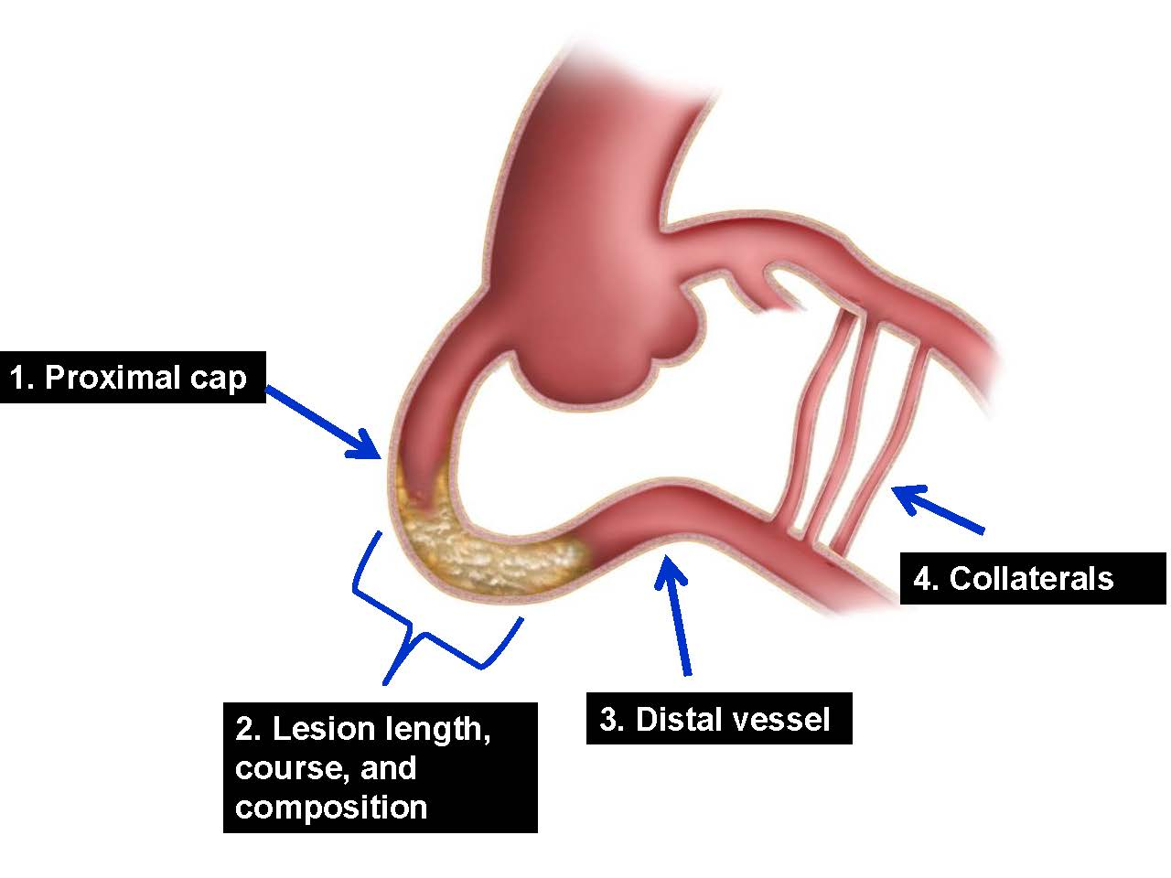

The hybrid approach to CTO intervention
Figure 2
Overview of the updated hybrid algorithm.
Emmanouil S. Brilakis, Lorenzo Azzalini, Dimitrios Karmpaliotis, William Nicholson, Stephane Rinfret
©2025 Europa Group - All rights reserved.

