Slide 1


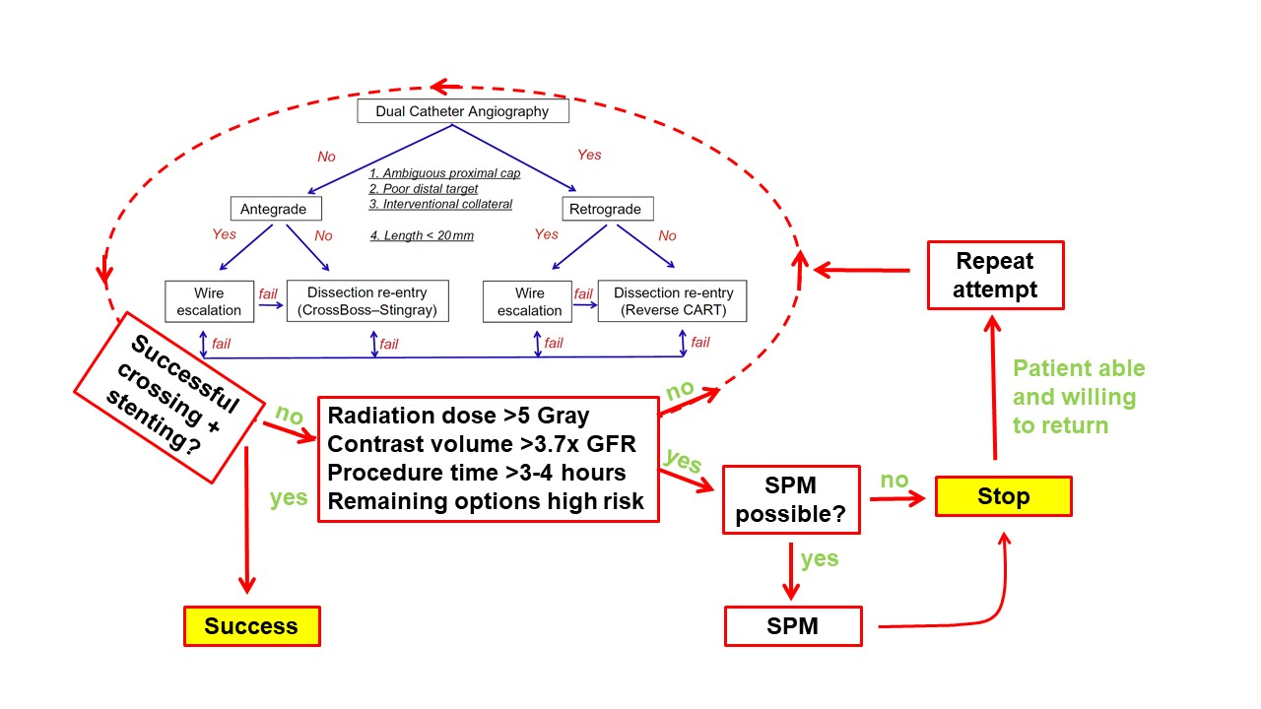

The hybrid approach to CTO intervention
Figure 3
Review of the coronary angiogram for planning CTO percutaneous coronary intervention.
Emmanouil S. Brilakis, Lorenzo Azzalini, Dimitrios Karmpaliotis, William Nicholson, Stephane Rinfret
©2025 Europa Group - All rights reserved.

