Slide 1


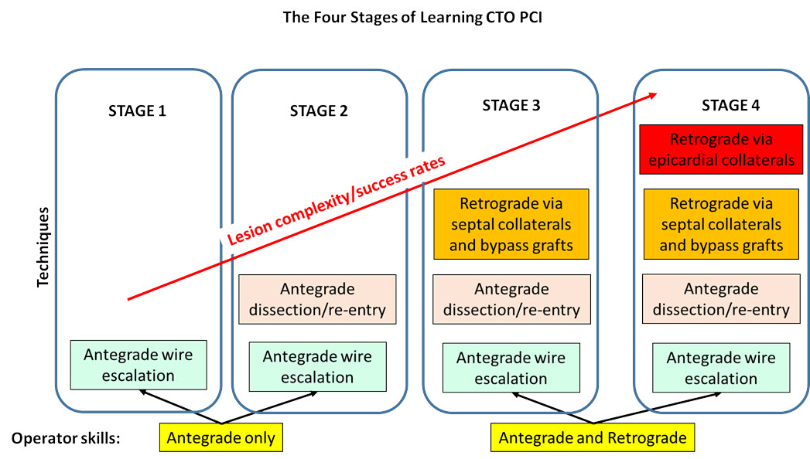

The hybrid approach to CTO intervention
Figure 5
The 4 stages of learning CTO PCI.
Emmanouil S. Brilakis, Lorenzo Azzalini, Dimitrios Karmpaliotis, William Nicholson, Stephane Rinfret
©2025 Europa Group - All rights reserved.

